Slide 1
“SALES AND MARKETING STRATEGIES OF ELECTRONİC CIGARETTES TARGETING YOUNG PEOPLE”
Sara Evli Özhan
International Cooperation Expert, Turkish Green Crescent Society

Slide 2
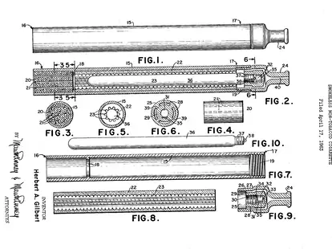
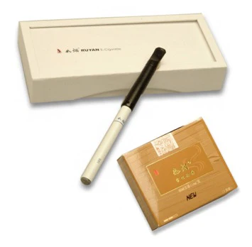
E-cigarette Then And Now
1960, Herbert Gilbert invented "smokeless non-tobacco cigarette" but it was not commercialized.
1979, Phill Ray and Norman Jacobson developed non-electric "smokeless cigarette", coining "vaping". Their product failed mass production.
2003, Hon Lik invented successful ECIG. "Ruyan".
2004, ECIG commercialized in China.
2007, entered US, kickstarting widespread use.
Global vaping up since.
Ongoing safety debates and some ban/restrictions.

Slide 3
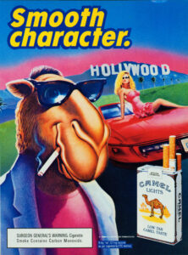
MARKETING STRATEGIES’ HISTORY
1780s: Early newspaper ads by Lorillard brothers remained unchanged for 70 years
New methods developed with greater youth appeal including:
Vibrant imagery
Memorable messaging
Free gifts
1870s: Early sponsorship - Tobacco cards featuring athletes to associate smoking with health and strength
1920s: Targeting women's liberation - Lucky Strike campaign using women's rights message
1950s: Leveraging television - Making smoking more visible in the home through TV ads
1980s: Cartoon branding - RJ Reynolds' controversial Joe Camel campaign directly appealing to children
2010s: Youth-focused slogans - Philip Morris' "Don't be a Maybe, Be Marlboro" campaign for 18-24 years olds.
2020s: Stealth social media advertising - JTI campaign disguising cigarette brand pages as music/travel sites to evade policies
Joe Camel Cartoons

Slide 4
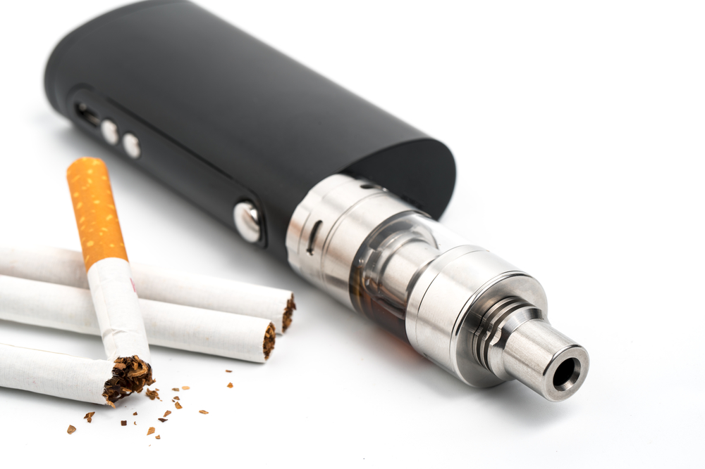
MARKETING TACTICS
Cartoon-like branding and slogans
Sweet and fruity flavored vape pod products.
Use of Social Media and TV Influencers and celebrities.
Event sponsorships.
Use of sexually appealing contents.
Video games, virtual reality and Sports.

Slide 5
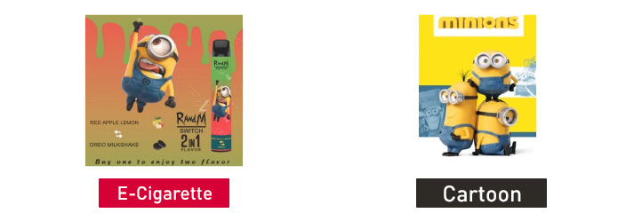

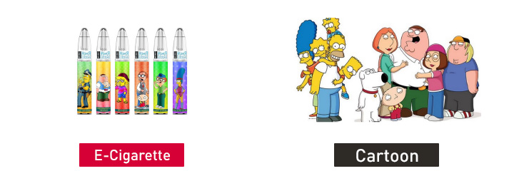
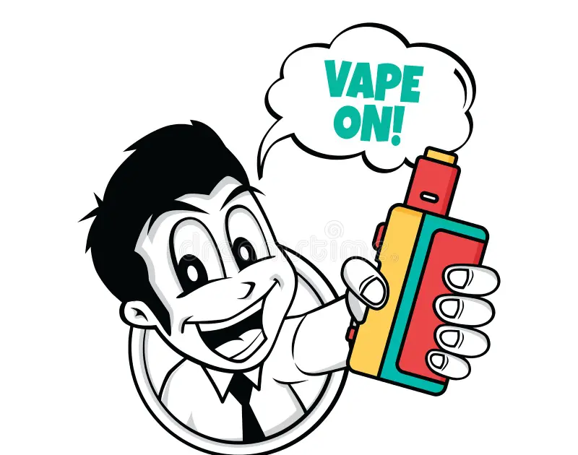
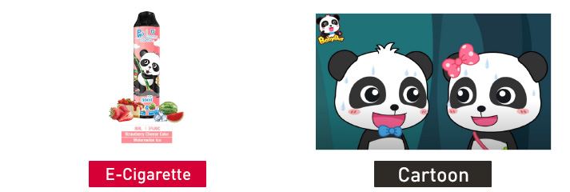
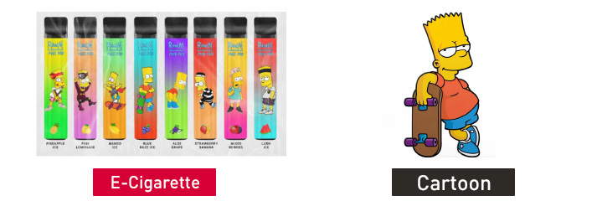
Cartoon-like Branding And Slogans
In the US, the 1998 Master Settlement Agreement restricted major tobacco brands from using cartoons in marketing.
The WHO Framework Convention on Tobacco Control also recommends not depicting tobacco in youth entertainment like cartoons.
There are currently no such bans or restrictions on the use of cartoons in marketing of e-cigarettes and vaping products.

Slide 6
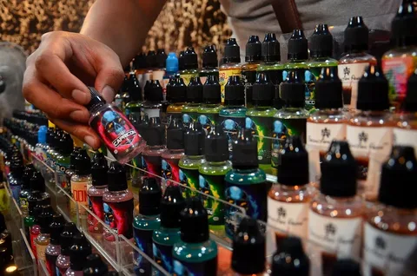

Sweet And Fruity Flavored Vape Pod Products
The extensive flavor variety of e-cigarettes is a major distinguishing trait that studies suggest appeals strongly to youth and influences the selection of first tobacco products, warranting further policy examination.
In a large study of Texas youth and adults, 99% of youth, 71% of young adult, and 44% of older adult current ECIG users reported that their first ECIG was flavored, but not tobacco flavored.
Compared to non-flavored tobacco products, flavored tobacco products are viewed more favorably.

Slide 7
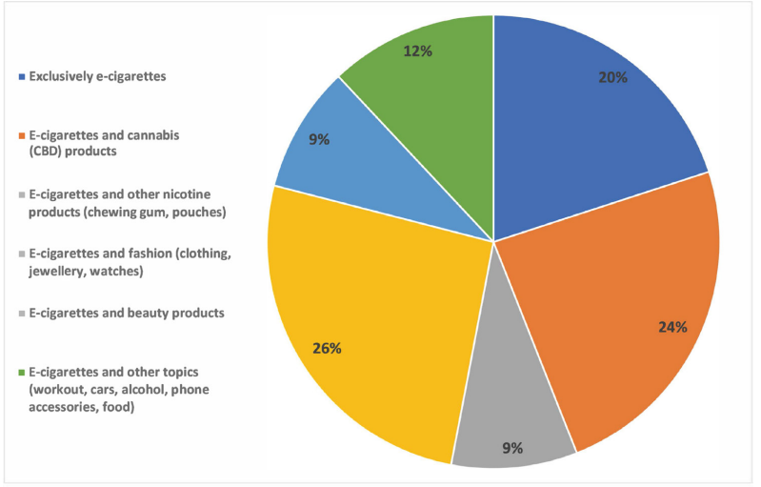
Use Of Social Media And TV Influencers And Celebrities
E-cigarette promotion through various channels like TV and social media influencers has led to more positive perceptions of vaping and greater intentions to use among youth.
A content analysis of e-cigarette discussions on Twitter found it was a major source of ads and promotion.
Over 26% of tweets contained marketing, advertising or promotional content - making this the largest category of tweets analyzed.
Twitter has therefore been identified as a key platform where e-cigarette companies actively advertise and promote their products, which can influence youth uptake and perceptions of vaping.
*Proportion of the influencers who posted about e-cigarettes compared with the influencers who posted about e-cigarettes and other topics on Instagram 2020.

Slide 8


Use Of Social Media And TV Influencers And Celebrities
Katherine Heigl was the first celebrity to openly use an e-cigarette on TV when she appeared on Live with David Letterman. She claimed it helped her quit smoking and wasn't harmful, encouraging Letterman to try it.
In the UK, characters on popular TV shows like EastEnders and Lewis have used e-cigarettes, promoting the products through mainstream programming.
Hollywood celebrities in the US have also promoted e-cigarette use on talk shows, discussing how they help with smoking cessation.
Johnny Depp's character used an e-cigarette in the film The Tourist, further normalizing them.
Other celebrities like Leonardo DiCaprio, Dennis Quaid, and Kevin Connolly have been photographed with e-cigarettes. Company websites even display images of famous people using their brands.
Netflix's popular Formula 1 series "Drive to Survive" gives tobacco brands new publicity by heavily featuring teams sponsored by PMI and BAT.
Katherine Heigl on Live With David Letterman Show
Johny Depp Smoking e-sigarette in The Tourist movie

Slide 9

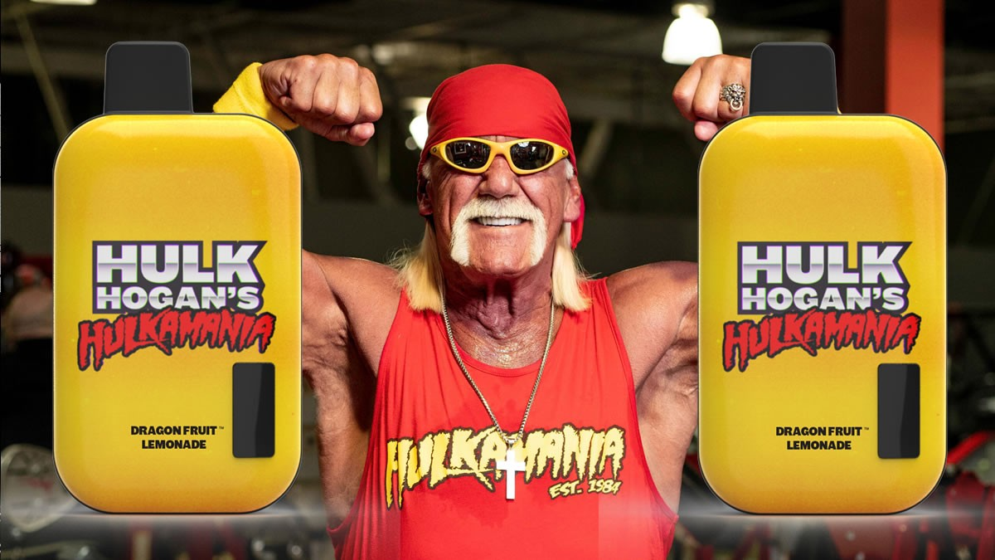
Other Entertainment Celebrities’ Brands:
Mike Tyson's brand is called Iron Mike Vapes. It features imagery of Tyson like his tattoos and bitten ear. They recently rebranded as Tyson 2.0 with improved devices.
Floyd Mayweather's brand is TMT Vapes, standing for The Money Team. They focus on disposable e-cigarettes for convenience.
Hulk Hogan's brand is called Immortal Vapes, tying into his wrestling persona. They sell disposables with his iconic looks and catchphrases.
Snoop Dogg launched Death Row Vapes, named after his record label. His devices come in 5000 and 7000 puff editions.
Berner, founder of the Cookies cannabis brand, launched Cookies e-liquids and uses advanced mixing techniques.
Musician Afroman has his Afro Vapes brand selling CBD and nicotine vapes aimed at a wide age range.
Mike Tyson - Iron Mike Vapes
Hulk Hogan - Immortal Vapes

Slide 10
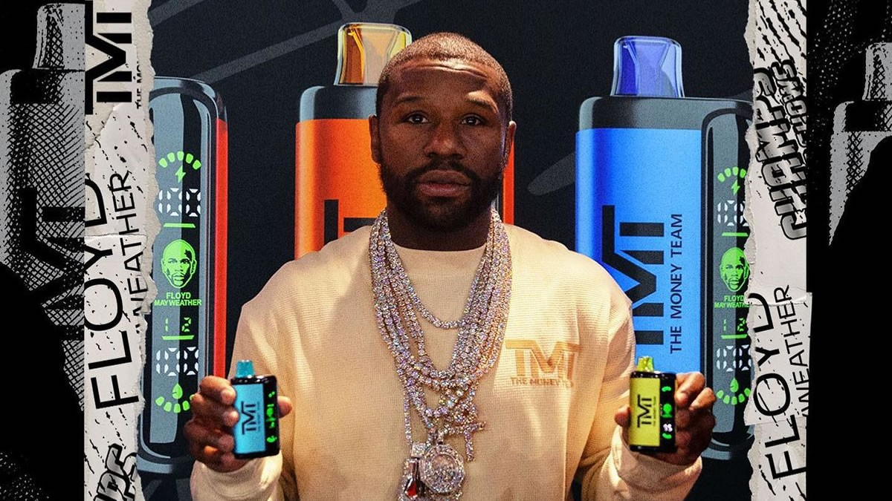


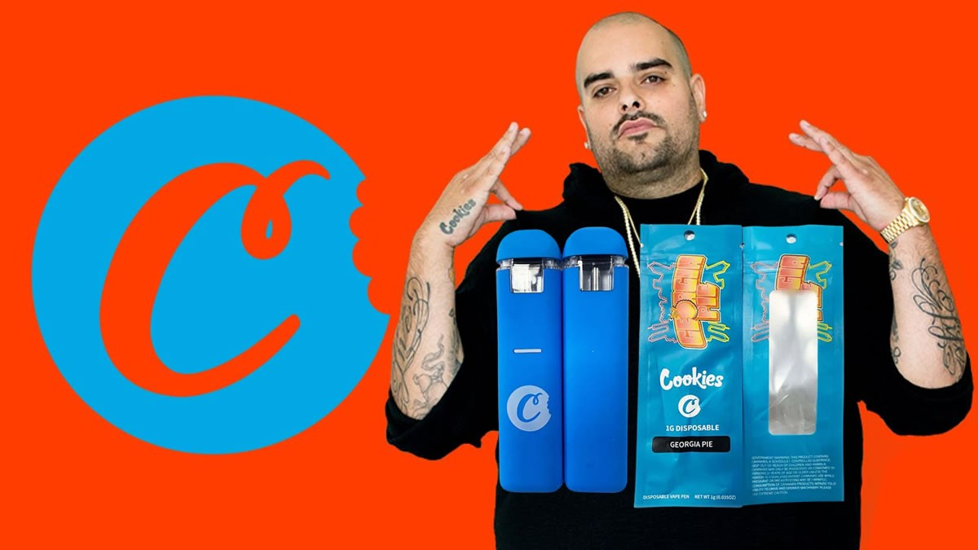
Floyd Mayweather - TMT Vapes
Afroman - Afro Vapes
Snoop Dogg - Death Row Vapes
Cookies CBD vape by Berner

Slide 11
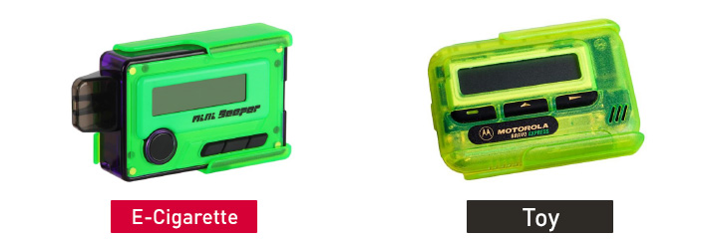
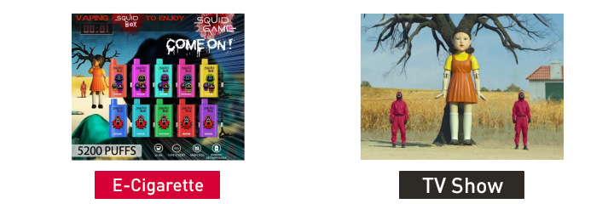
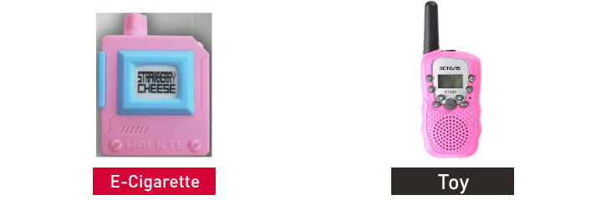
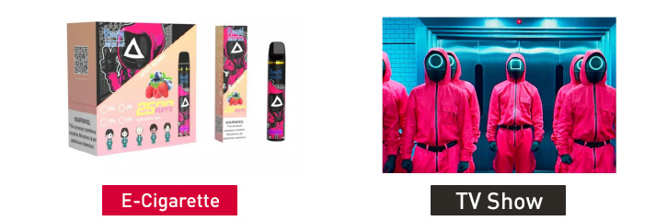
Gaming, virtual life, Sports, Music and Fashion
Video games and virtual reality: TTCs develop their own video games and advertise through advergaming to target youth. They are now venturing into the metaverse with unclear regulations.
In Indonesia, a cigarette company sponsored virtual parties on Instagram targeting young introverts, circumventing advertising restrictions.
Music, art and fashion: TTCs use music sponsorship to associate products with creativity and self-expression.
Examples of tobacco sponsorships include a cigarette company connecting music concerts to online campaigns in Indonesia, and a BAT subsidiary targeting young women through fashion events in Australia.
Philip Morris Italia sponsored a scouting event linking innovative designers to its heated tobacco product.
JTI has sponsored cultural venues like museums and orchestras.
Football: TTCs have a long history leveraging football promotions before FIFA bans in late 1980s. However, companies still find ways around bans, like a BAT campaign during 2002 FIFA World Cup on Malaysian TV.
Digital marketing is now used to launch football-themed packs and endorse stars, sponsor broadcasts and match viewings.
In Indonesia in 2022, a cigarette brand hosted "Soccerphoria" events blending sports and art to promote limited World Cup packs targeting youth.

Slide 12
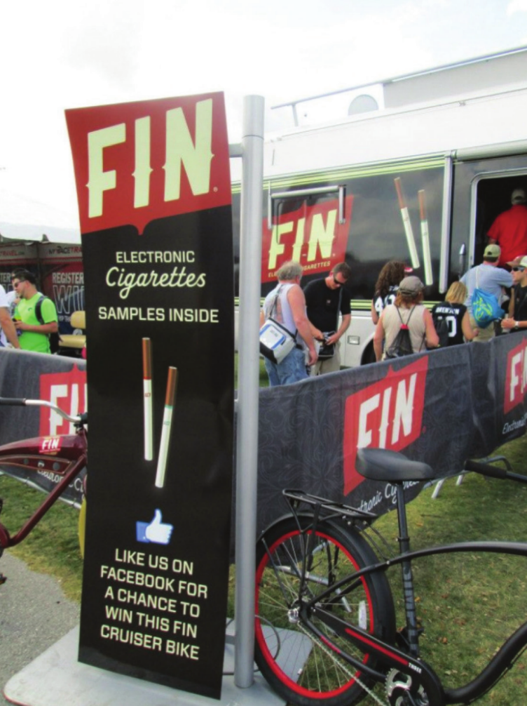
EVENT SPONSORSHİPS
JUUL sponsored life festivals and concerts in 2017-2018 attending by youth, including Life is Beautiful in Vegas and Breakmusic in Portland.
NATURAL American Spirit sponsored concerts by indie bands, including Diet Cig and Jay Som. Their events attracted youth audiences.
Blu ESIGS sponsored the 2012 Reggae Sumfest in Jamaica, a large music festival.
VUSE sponsored the 2013 Australian Open tennis tournament, leveraging a popular annual sporting event.
Electronic Nicotine Delivery Systems sponsored the 2012 Vans Warped Tour concert series, which included acts popular among teens.
E-cigarette sponsorship of an event, photograph from the January 2015 California Department of Public Health's State Health Officer's Report on E-Cigarettes.

Slide 13
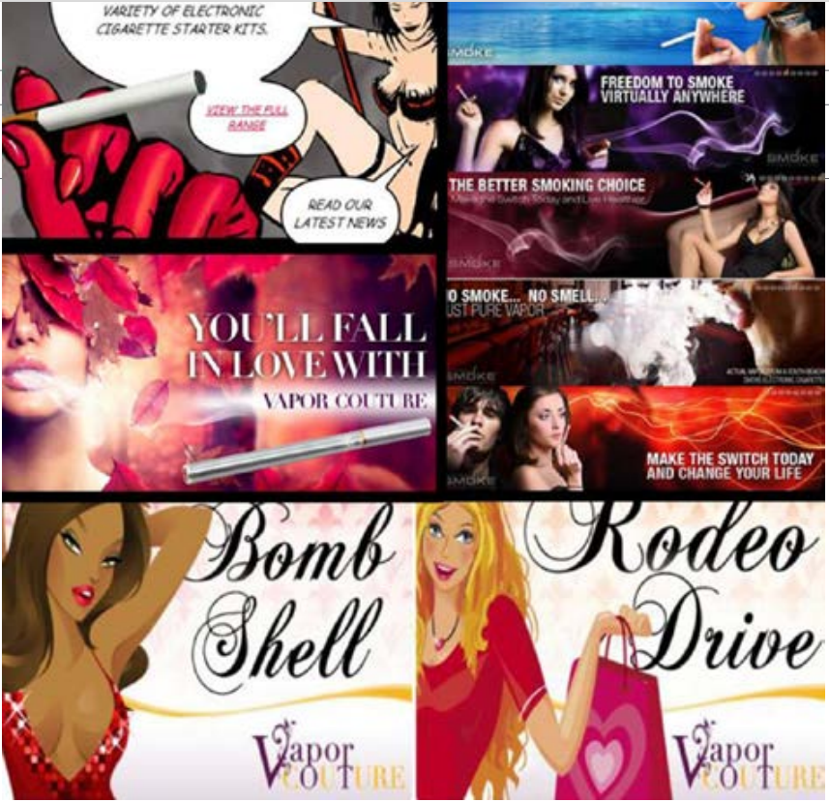
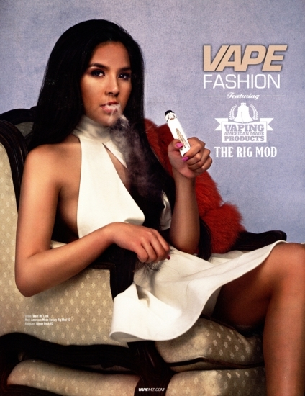
SEXUALLY APPEALİNG CONTENT
A 2019 study analyzed JUUL's Instagram posts from 2015-2018 and found 13% contained sexually suggestive imagery, mostly featuring young women in provocative poses. The study concluded JUUL disproportionately promoted its product using sexually appealing/romanticized content on Instagram during this time period.
A 2021 study of JUUL's marketing found it portrayed its product paired with sexy dressed models and in romantic/sexualized imagery like couples close together or kissing. Hashtags like #coolandsexy were used.
Data from Monitoring the Future survey found e-cigarette use among 12th graders tripled between 2017-2018, corresponding with JUUL's "Vaporized" campaigns featuring young models suggesting sex appeal.
Analyses of JUUL hashtags and posts found use of #couplesgoals, #girlsnight, #summervibes alongside product promotion - imagery that plays on romantic/social themes appealing to teens.
Internal documents revealed JUUL sought to target 20-30 years old social media users by using "branded content with innovative pictures, captioned with light, playful copy" focused on intimacy/pleasure.
Examples evocative images used in advertising of e-cigarettes in the UK and US.

Slide 14
DATA AND STATİSTİCS
In 2011, 1.5% of high school students reported using e-cigarettes in the past 30 days.
By 2014, 13.4% of high school students reported past 30 day e-cigarette use.
In 2015, 16% of high school students reported past 30 day e-cigarette use.
In 2017, 11.7% of high school students reported past 30 day e-cigarette use.
In 2018, 20.8% of high school students and 4.9% of middle school students reported past 30 day e-cigarette use.
Vision

Slide 15
INDUSTRY SPENDİNG
In 2014, blu ECIGs spent $24 million on advertising and promotion, up from $12 million in 2013.
In 2017, Juul spent $100 million on advertising and promotions, including sponsoring concerts and other youth-focused events.
In 2018 alone, Juul nearly doubled their 2017 spending on advertising and promotional activities to $200 million.
From 2015-2018, Juul increased their annual marketing budget from $1.3 million to $100 million - or a growth of 7,500%. Around 60% of Juul's 2018 budget was dedicated to promotional initiatives.
In 2018, Vuse allocated over $19 million to e-cigarette promotion across various media including TV, radio and retail outlets.

Slide 16
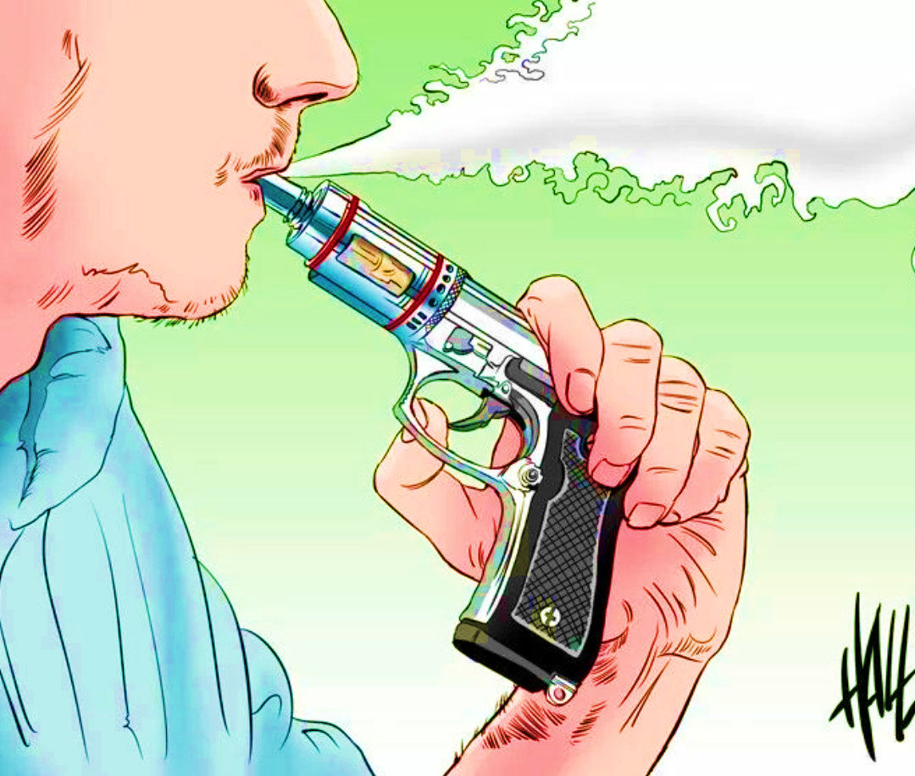
INDUSTRY REVENUES
The global e-cigarette market was estimated to be worth around $15.7 billion in 2018. It is projected to grow at a compound annual growth rate of 23.3% from 2019 to 2025, reaching a value of $48.0 billion.
In 2020, the global e-cigarette market was estimated at around $19.3 billion. It is projected to grow to over $78.8 billion by 2027.
In 2021, the global e-cigarette and vaping market was valued at approximately $21.5 billion. It is expected to grow at over 9% annually, reaching $37.2 billion by 2028.
The US market for e-cigarettes was estimated to be worth around $10.8 billion in 2018 according to a report from Forbes. The US accounted for over 60% of the global vaping market that year.
The UK e-cigarette market was valued at around £1.3 billion (US$1.7 billion) in 2020 according to figures from the UK Vaping Industry Association.

Slide 17
CONSUMER PERCEPTIONS
A 2019 study found youth who were frequently exposed to e-cigarette social media ads were more likely to believe vaping is cool (OR=1.40), harmless (OR=1.54), and associates it with independence (OR=1.37).
A 2020 study found youth who visited websites of e-cig brands had 3.6 greater odds of believing vaping helps people quit smoking compared to non-visitors.
Another 2020 study found 48% of middle/high school students reported seeing 2020 SUPER BOWL e-cig ads, and those exposed were 3.5x more likely to think friends’ opinions of vaping became more positive.
A survey found over 28% of US/UK/Canada youth saw e-cig ads, and youth who did were significantly more likely to think vaping is cool/understandable.

Slide 18
References
Centers for Disease Control and Prevention (CDC) - Government health agency with research on e-cigarette use trends, dangers, regulations: https://www.cdc.gov/tobacco/basic_information/e-cigarettes/index.htm
Truth Initiative - Nonprofit focused on tobacco issues, data on youth vaping epidemic: https://truthinitiative.org/research-resources/emerging-tobacco-products
World Health Organization (WHO) - International health body, information on global health impacts of ENDS: https://www.who.int/news-room/fact-sheets/detail/tobacco
U.S. Food and Drug Administration (FDA) - Government agency overseeing ENDS regulations, youth prevention efforts: https://www.fda.gov/tobacco-products
Campaign for Tobacco-Free Kids - Advocacy group compiling policy/research resources: https://www.tobaccofreekids.org/what-we-do/industry-watch/e-cigarettes
Public Health England - UK agency, balanced view of potential risks/benefits of vaping as tool to help smoking cessation: https://www.gov.uk/government/publications/e-cigarettes-an-evidence-update
TobaccoTactics.org - Wiki edited by academics/researchers on industry marketing techniques: https://tobaccotactics.org/wiki/e-cigarettes /(Soneji et al., 2019)
(Soneji et al., 2020)
(Dai & Hao, 2020)
(Padon et al., 2021)
(Report Linker, 2020)
(Fortune Business Insights, 2021)
(Research and Markets, 2022)
(Forbes, 2019)
(UK VIA, 2021)

Slide 19
(Federal Trade Commission, 2015)
(Truth Initiative, 2018)
(Truth Initiative, 2019)
(Jackler et al., 2019)
Federal Trade Commission, 2020)
Centers for Disease Control and Prevention, 2019
(Centers for Disease Control and Prevention, 2016).
(Centers for Disease Control and Prevention, 2014).)
(Truth Initiative)
Campaign for Tobacco-Free Kids)
(UCSF)
Tobacco Industry Targeting Young People - Tobacco Tactics
10 Really Bad Things the Tobacco Industry Has Done – and Is Doing – to Entice Kids to Start Smoking | American Lung Association
Vogel, Erin & Guillory, Jamie & Ling, Pamela. (2020). Sponsorship Disclosures and Perceptions of E-cigarette Instagram Posts. Tobacco Regulatory Science. 6. 355-368. 10.18001/TRS.6.5.5.
Playtime: vaping devices designed as cartoons and toys may appeal to kids | Tobacco Control (bmj.com)
Unauthorized E-cigarettes that Appeal to Youth | FDA
New 'smart vapes' 'attract' kids with built-in video games (nypost.com)
Playtime: vaping devices designed as cartoons and toys may appeal to kids | Tobacco Control (bmj.com)
E-Cigarettes - Worldwide | Statista Market Forecast
E-cigarette | Characteristics, Safety Issues, & Regulation | Britannica
What Year Was The Electronic Cigarette Invented? | CitizenSide

Slide 20
Thank You For Listening

