Slide 1
Policy Developments Regarding The E-Cigarette In The Netherlands & Health Effects Of Vaping
Manon Waning
Lung Foundation Netherlands

Slide 2
Introduction
Policy Advisor at Lung Foundation Netherlands
Health Funds for Smokefree Netherlands
Knowledge based & lobby organization
Goal: Smokefree generation in 2035
Notes:
Top-down en bottom up

Slide 3
Health Effects of Vaping

Slide 4
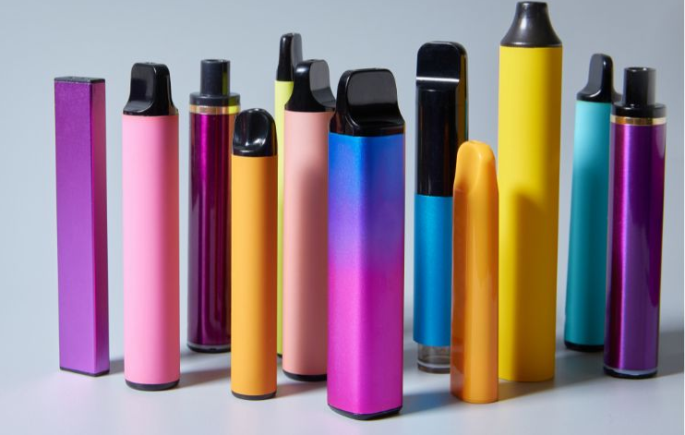
What is a ‘vape’
Electronic device that heats liquids to produce aerosol to inhale
Liquid contains nicotine, carrier substances (propeenglycol and glycerol)
Flavors
Disposable and refillable
Notes:
Disposable meest gebruikt, veel verschillende kleuren en designs

Slide 5
Health effects
Short term
Respiratory tract: Shortage of breath, coughing
Cardiovascular: high blood pressure
Long term
DNA damage → cancer
Nicotine disrupts brain development
Problems with concentration
Anxiety
Notes:
Long term nog onbekend, wel effecten van carrier substances en nicotine bekend. Brain development tot 25, dus vooral probleem bij jongeren waar hersenen nog moeten ontwikkelen.

Slide 6
Health effects
Vaping is a stepping stone to smoking
Youth who vapes are three times more likely to start smoking
70% of youth (12-25) who vaped monthly, also smoked monthly
50% of students (12-16) who vaped last month, also smoked last month
Notes:
Naast health effects van vape zelf, health effects van tabak en die zijn wellkown. Duaal gebruik nog erger

Slide 7
Policy developments

Slide 8
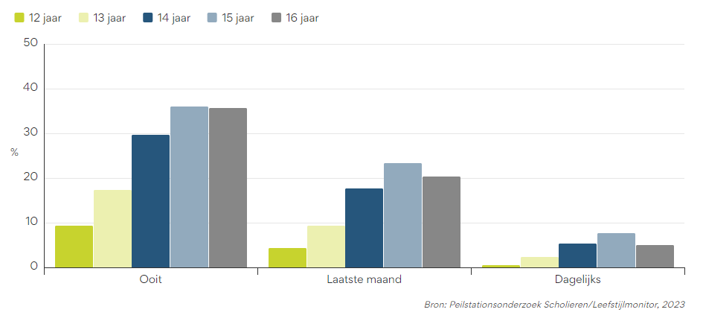
Prevalence
Students between 12-16
24,6% ever vaped
14,3% vaped last month
4% vaped daily

Slide 9
Perception vaping in the Netherlands
Vape epidemic among youth is huge problem
Much willingness to attack problem
Measures for vaping and smoking should be equalized
Notes:
Politieke situatie: mensen kunnen zelf keuzes maken, maar over beschermen kinderen is iedereen het eens.

Slide 10
Tobacco products directive
Age limit; no sales under 18
Warning labels
Not allowed in smoke free environments
Requirements for liquid and volume
Notes:
cafés, restaurants, openbare gebouwen en op werkplekken. Scholen. En op vrijwillig rookvrije plekken

Slide 11
Flavour ban
Flavours are very appealing to youth
Only tobacco flavours allowed
List of 23 flavorings
Since January 1st 2023
Enforced since January 1st 2024
Notes:
Uitverkoop termijn: vertraagd door rechtszaak en verkeerde berekening met lijst.

Slide 12
Points of sale
Sales ban in catering industry, online and supermarkets
Sale aloud in gas stations, convenience stores and tobacco specialty stores
From 2026, vapes can only be sold in tobacco specialty stores
Notes:
Dus vapes eerder naar speciaalzaken dan tabak.

Slide 13
Price
Price is important factor for accesibility vapes for youth
Excise tax for vapes not regulated in TTD (Tobacco Tax Directive)
National consumption tax
Majority of House of Representatives in favor
Very complex and no capacity
Waiting for update of TTD
Notes:
Jongeren minder geld beschikbaar. Wilden niet al het werk doen voor max. 1 jaar profijt.

Slide 14
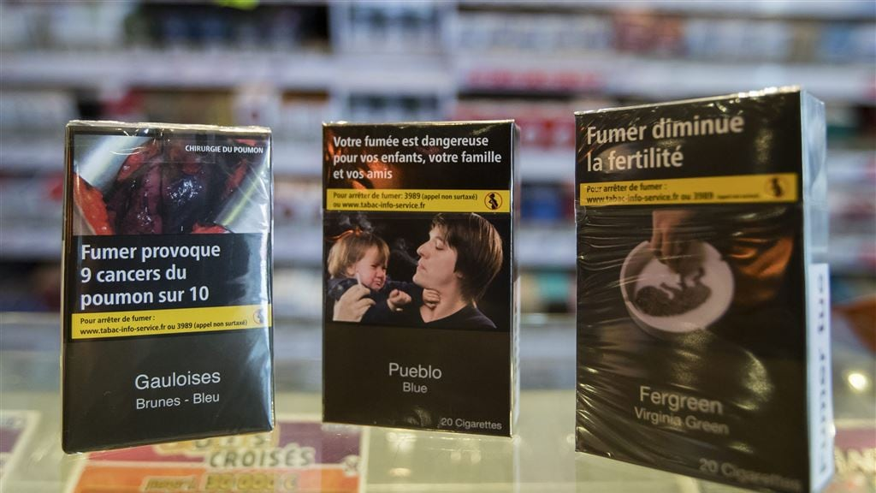
Neutral packaging
Goal is to reduce attractiveness
Unattractive colour
Same standard font
Health warning is more visible
January 1st 2025

Slide 15
Current situation
Still, many young people vape (with flavours)
Illegal market has grown
Need for better enforcement
Notes:
Te vroeg om te zeggen dat flavor ban niet werkt, nog niet lang genoeg bezig. Maar zien nu niet het effect wat we willen zien.

Slide 16
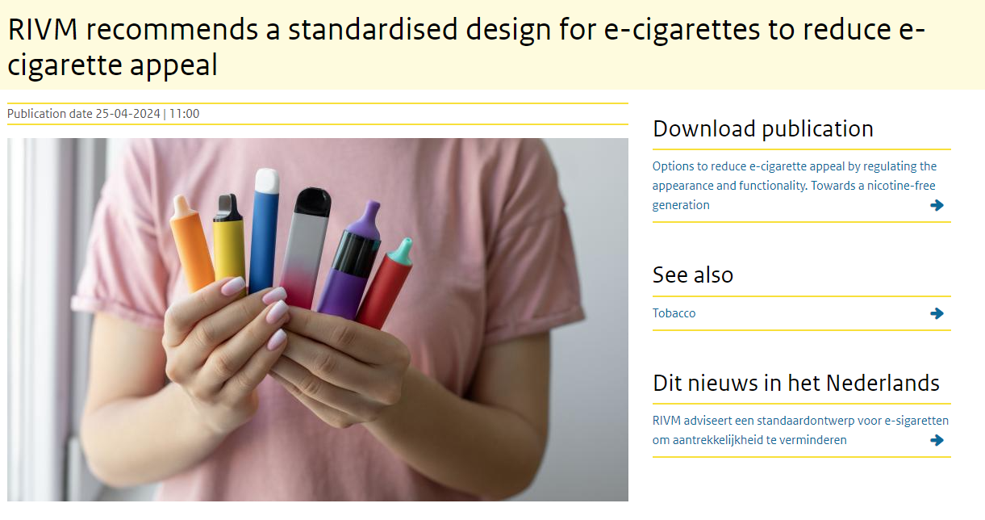
Potential measures
National tax
Standardised design
Ban on disposable vapes
Total ban on vapes

Slide 17
Questions? contact: manonwaning@longfonds.nl

