Slide 1
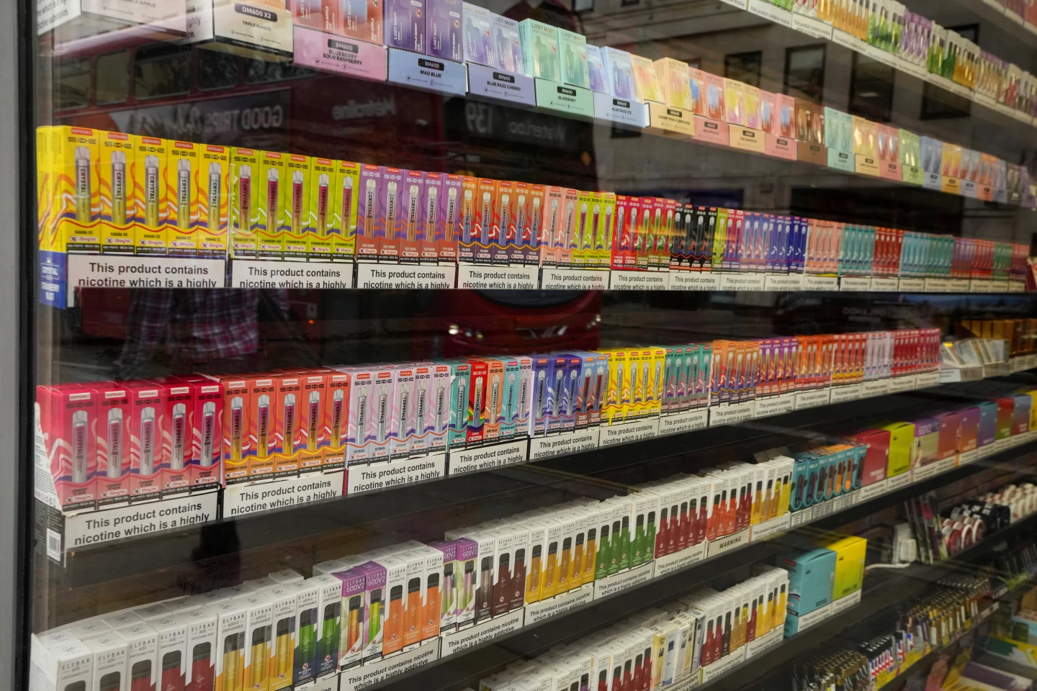
Plastic Waste and other Environmental Threats Posed by E-cigarettes

Slide 2
Who we are

Slide 3

SFP Coalition
SFP currently has 57 partners across Europe. SFP Coalition partners recognise the fundamental importance of strengthening cooperation on tobacco control.
SFP Secretariat is the voice of the Coalition partners at the EU level.

Slide 4

Coalition Partners
As a member-based organisation, SFP relies on its Partners to gain insights on national developments on tobacco control.
As of right now, SFP counts 57 Partners across Europe:
6 Main Partners
1 Associate Partner
50 Advocacy Partners

Slide 5
Coalition Partners
SFP Coalition consists of 57 Partners across Europe, including Turkey and Israel.

Slide 6




























































Coalition Partners

Slide 7
AGENDA
1
What are e-cigarettes
2
Environmental impact
3
EU Regulations
4
Conclusion

Slide 8
What are e-cigarettes?
1

Slide 9
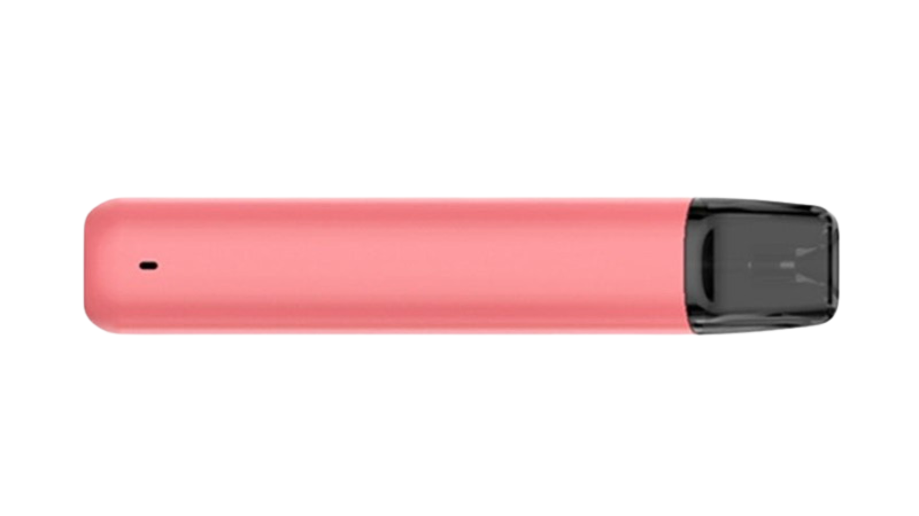
«A type of electronic nicotine delivery system that heat a solution to deliver an aerosol that is subsequently inhaled by the user. Many e-liquids already contain nicotine. They do not contain tobacco except nicotine, which originates from it. Alternative names for these products include vaping products»‬¹
¹WHO. (2024). Tobacco: E-cigarettes. https://www.who.int/news-room/questions-and-answers/item/tobacco-e-cigarettes

Slide 10
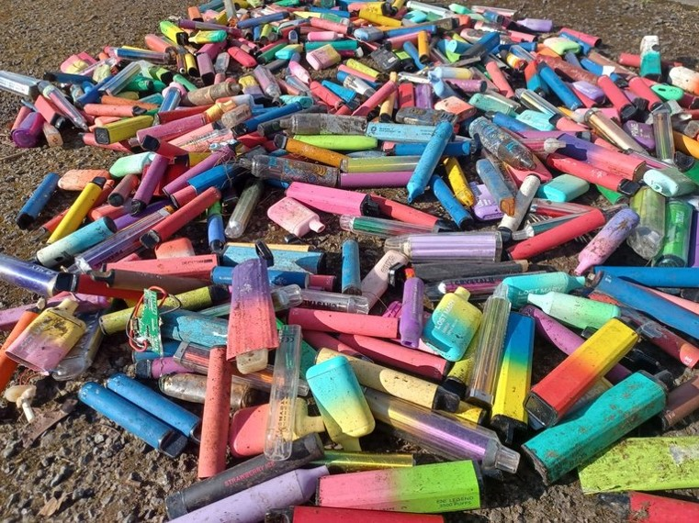

Disposable e-cigarettes are:
non-rechargeable
non-refillable
Disposable e-cigarettes are also called vapes

Slide 11
Plastics
E-cigarettes contain:

Slide 12
Atomizers
Metal coils
Chips
Lithium

Slide 13
Metal coils
Atomizers
These are often single-use, disposable products made with non-biodegradable and non-recyclable materials that can cause damage to the environment.
Chips
These products, along with other substances in e-cigarette liquids known to be toxic to human health, can impact the health of non-smokers if not disposed of properly.
Lithium
Plastics

Slide 14
Size of the issue
Entity
Lack of data
Some research
Market share
The exact environmental impact of these products remains unclear, as there is little independent data assessing the lifecycle impact of these products.
In the UK, 360 million vapes were sold in 2022¹.
8 vapes are thrown away each second in the UK¹.
75% of users never recycle their used devices².
Size of the global market increased from $7.8 bln in 2015 to $22.4 bln in 2022³.
2018-2022: market increase of 116% for disposable vapes, with 550,000 different products³.
¹Material Focus. (2023). Number of disposable single-use vapes thrown away have in a year quadrupled to 5 million per week. https://www.materialfocus.org.uk/press-releases/disposable-single-use-vapes-thrown-away-have-quadrupled-to-5-million-per-week/
²Euronews. (2023). Planet of the vapes: How big a problem are e-cigarettes, and where can they be recycled?https://www.euronews.com/green/2023/08/01/planet-of-the-vapes-how-big-a-problem-are-e-cigarettes-and-where-can-they-be-recycled
³ WHO. (2024). E-cigarettes. https://iris.who.int/bitstream/handle/10665/376682/WPR-2024-DHP-001-eng.pdf?sequence=1

Slide 15
Size of the issue
Entity
Lack of data
Some research
Market share
The exact environmental impact of these products remains unclear, as there is little independent data assessing the lifecycle impact of these products.
In the UK, 360 million vapes were sold in 2022.
8 vapes are thrown away each second in the UK. 75% of users never recycle their used devices.
¹Material Focus. (2023). Number of disposable single-use vapes thrown away have in a year quadrupled to 5 million per week. https://www.materialfocus.org.uk/press-releases/disposable-single-use-vapes-thrown-away-have-quadrupled-to-5-million-per-week/
²Euronews. (2023). Planet of the vapes: How big a problem are e-cigarettes, and where can they be recycled?https://www.euronews.com/green/2023/08/01/planet-of-the-vapes-how-big-a-problem-are-e-cigarettes-and-where-can-they-be-recycled
³ WHO. (2024). E-cigarettes. https://iris.who.int/bitstream/handle/10665/376682/WPR-2024-DHP-001-eng.pdf?sequence=1

Slide 16
Size of the issue
Entity
Lack of data
Some research
Market share
The exact environmental impact of these products remains unclear, as there is little independent data assessing the lifecycle impact of these products.
In the UK, 360 million vapes were sold in 2022.
8 vapes are thrown away each second in the UK. 75% of users never recycle their used devices.
¹Material Focus. (2023). Number of disposable single-use vapes thrown away have in a year quadrupled to 5 million per week. https://www.materialfocus.org.uk/press-releases/disposable-single-use-vapes-thrown-away-have-quadrupled-to-5-million-per-week/
²Euronews. (2023). Planet of the vapes: How big a problem are e-cigarettes, and where can they be recycled?https://www.euronews.com/green/2023/08/01/planet-of-the-vapes-how-big-a-problem-are-e-cigarettes-and-where-can-they-be-recycled
³ WHO. (2024). E-cigarettes. https://iris.who.int/bitstream/handle/10665/376682/WPR-2024-DHP-001-eng.pdf?sequence=1

Slide 17
Environmental Impact
2

Slide 18
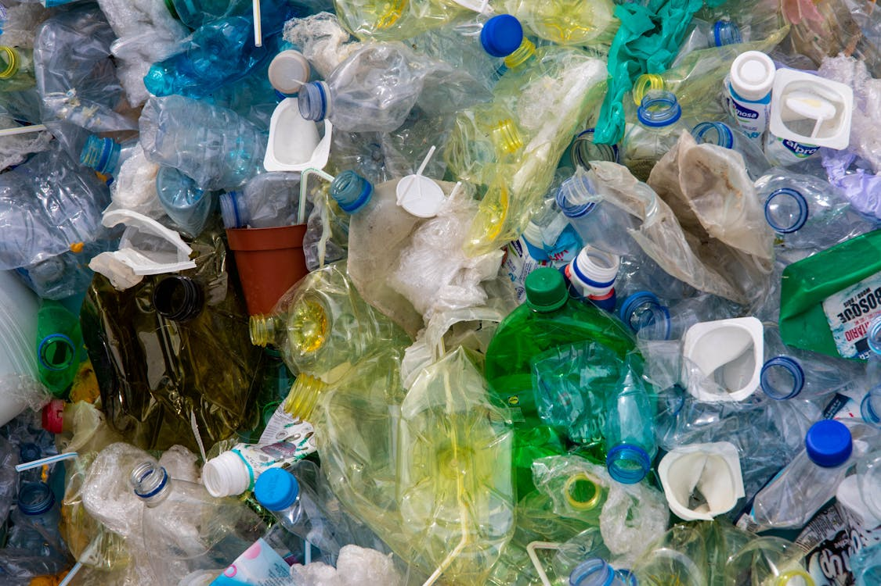
01
PLASTICS
Most plastic e-cigarette liquid containers are single-use and non-recyclable, often ending up in drains, streets, and waterways¹.
The growing popularity of e-cigarettes has led to more improper disposal of these plastic parts, which do not decompose and instead break down into harmful microplastics².
Plastics in e-cigarettes have been classified as “problematic” and “avoidable” in a FCTC COP Decision².
¹WHO. (2022). Tobacco: Poisoning our planet.https://iris.who.int/bitstream/handle/10665/354579/9789240051287-eng.pdf?sequence=1
²FCTC. (2024). COP10 adopted historic decisions to protect the environment from the harms of tobacco and to address cross-border tobacco advertising, promotion and sponsorship and the depiction of tobacco in entertainment media.https://fctc.who.int/newsroom/news/item/10-02-2024-cop10-adopted-historic-decisions-to-protect-the-environment-from-the-harms-of-tobacco-and-to-address-cross-border-tobacco-advertising-promotion-and-sponsorship-and-the-depiction-of-tobacco-in-entertainment-media

Slide 19
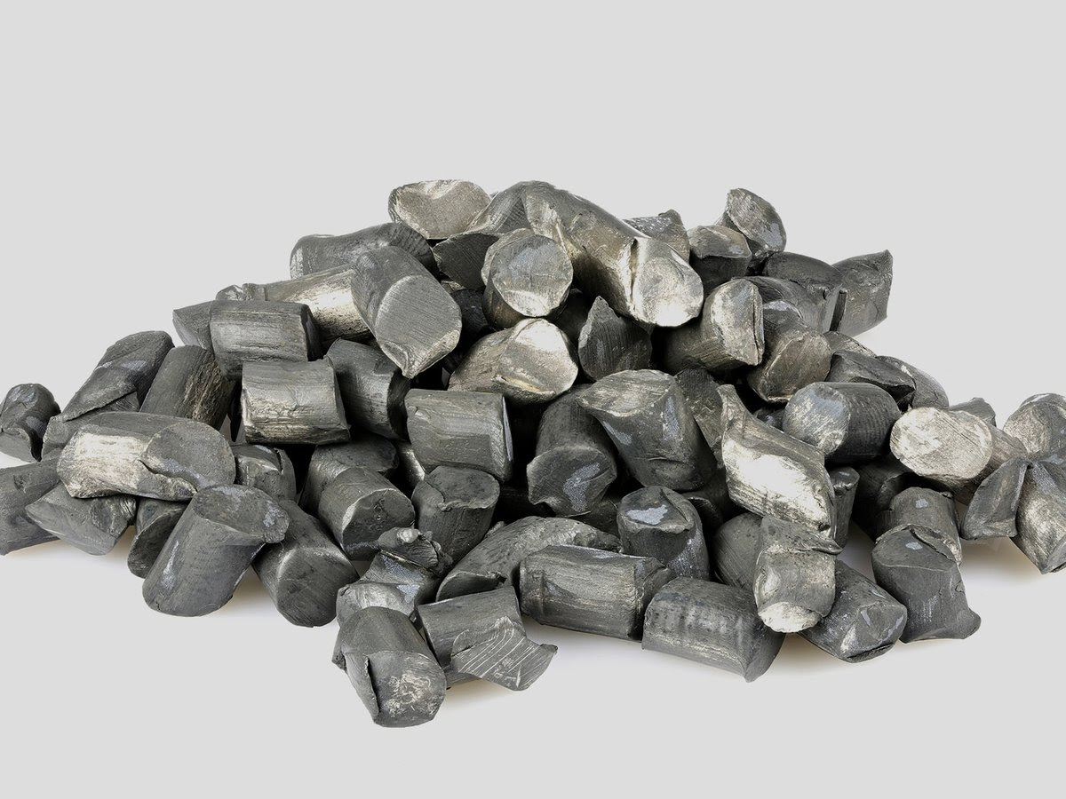
02
LITHIUM
Vapes contain 0.15g of lithium, a highly polluting material. Extracting just one tonne of lithium, requires 2 million litres of water and emits 15 tonnes of CO2, contributing to severe air pollution and water scarcity¹.
Lithium is a valuable resource that could be better used in electric vehicles. Additionally, when improperly discarded, damaged lithium batteries can cause fires at waste disposal sites².
¹Green Match. (2024). Is Lithium Mining Bad For The Environment? https://www.greenmatch.co.uk/blog/is-lithium-mining-bad-for-the-environment
²Euronews. (2023). Planet of the vapes: How big a problem are e-cigarettes, and where can they be recycled? https://www.euronews.com/green/2023/08/01/planet-of-the-vapes-how-big-a-problem-are-e-cigarettes-and-where-can-they-be-recycled

Slide 20

03
CHEMICALS
E-cigarettes contain various chemicals, many of which are harmful to both human health and the environment. Improper disposal can release these toxins, damaging ecosystems and affecting non-smokers.
Key harmful substances include acetaldehyde, formaldehyde, propylene glycol, acrolein, diethylene glycol, heavy metals like nickel, tin, and lead, as well as benzene¹.
¹American Lung Association. (2023). What's in an E-Cigarette? https://www.lung.org/quit-smoking/e-cigarettes-vaping/whats-in-an-e-cigarette

Slide 21

04
OCEANS
Non-biodegradable plastic casings from vapes threaten ocean creatures that may accidentally eat them, putting aquatic ecosystems at risk.
As the use of these single-use devices increases, so does the pollution in oceans and waterways, endangering marine life. Given their rising popularity, there is a serious risk that vapes become the predominant form of litter¹.
¹ Gutterman, L. R., & Fund, U. P. E. (2023). Vape Waste. https://publicinterestnetwork.org/wp-content/uploads/2023/07/Vape-Waste-Full-Report-PIRG.pdf

Slide 22
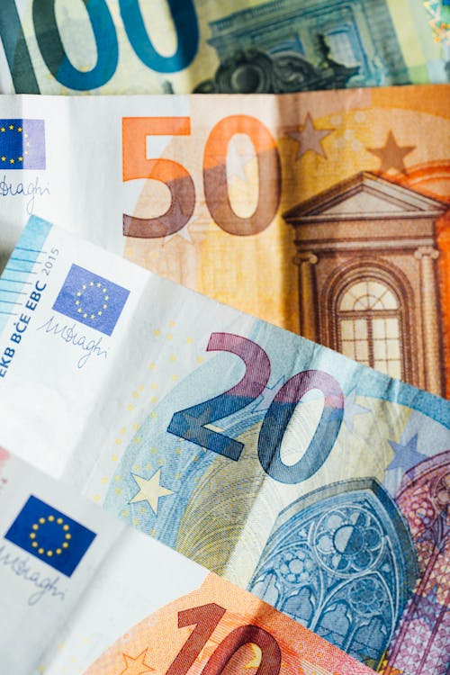
05
COST
Some estimates put the environmental cost of disposable vapes in the UK at more than USD 255 million, including clean-up and waterway pollution.

Slide 23
Regulations in Europe
3

Slide 24
Legislation
EU Law
When?
2022-2028 Interfederal strategy for a tobacco-free generation.
Reducing the number of smokers aged 15-24 to 6% or less by 2028.
Compliance with TPD.
Commission’s approval needed.
19/03/2024: Commission’s approval
Ban the sale of disposable electronic cigarettes containing nicotine from 1 January 2025.
BELGIUM
Entity

Slide 25
Legislation
EU Law
When?
2022-2028 Interfederal strategy for a tobacco-free generation.
Reducing the number of smokers aged 15-24 to 6% or less by 2028.
Compliance with TPD.
Commission’s approval needed.
19/03/2024: Commission’s approval
Ban the sale of disposable electronic cigarettes containing nicotine from 1 January 2025.
BELGIUM
Entity

Slide 26
Legislation
EU Law
When?
2022-2028 Interfederal strategy for a tobacco-free generation.
Reducing the number of smokers aged 15-24 to 6% or less by 2028.
Compliance with TPD.
Commission’s approval needed.
19/03/2024: Commission’s approval
Ban the sale of disposable electronic cigarettes containing nicotine from 1 January 2025.
BELGIUM
Entity

Slide 27
Legislation
EU Law
When?
Law No. 2022-1231 of December 24, 2022, relating to the fight against smoking and the regulation of tobacco products.
Amendment to ban single-use electronic vaping devices.
Compliance with TPD.
Commission’s approval needed.
Approval expected by the end of August 2024.
The government hopes the ban on disposable e-cigarettes containing nicotine will be effective by September 2024.
FRANCE

Slide 28
Legislation
EU Law
When?
Law No. 2022-1231 of December 24, 2022, relating to the fight against smoking and the regulation of tobacco products.
Amendment to ban single-use electronic vaping devices
Compliance with TPD.
Commission’s approval needed.
Approval expected by the end of August 2024.
The government hopes the ban on disposable e-cigarettes containing nicotine will be effective by September 2024.
FRANCE
Entity

Slide 29
Legislation
EU Law
When?
Law No. 2022-1231 of December 24, 2022, relating to the fight against smoking and the regulation of tobacco products.
Amendment to ban single-use electronic vaping devices
Compliance with TPD.
Commission’s approval needed.
Approval expected bu the end of August 2024.
The government hopes the ban on disposable e-cigarettes containing nicotine will be effective by September 2024.
FRANCE
Entity

Slide 30
Legislation
Who?
When?
UK Tobacco and Vapes Bill.
Ban of disposable e-cigarettes.
Tobacco-free generation.
Introduced by Sunak’s government in March 2024, it will be moved forward by the newly formed government led by Starmer.
Awaiting the third reading in the House of Commons.
The Bill is set to enter into force on 1 April 2025.
UK

Slide 31
Legislation
Who?
When?
UK Tobacco and Vapes Bill.
Ban of disposable e-cigarettes.
Tobacco-free generation.
Introduced by Sunak’s government in March 2024, it will be moved forward by the newly formed government led by Starmer.
Awaiting the third reading in the House of Commons.
The Bill is set to enter into force on 1 April 2025.
UK

Slide 32
Legislation
Who?
When?
UK Tobacco and Vapes Bill.
Ban of disposable e-cigarettes.
Tobacco-free generation.
Introduced by Sunak’s government in March 2024, it will be moved forward by the newly formed government led by Starmer.
Awaiting the third reading in the House of Commons.
The Bill is set to enter into force on 1 April 2025.
UK

Slide 33

Revision of the Tobacco Products Directive. Ongoing?
Lack an EU-level ban on the sale of disposable vapes.

Slide 34

Disclaimer
The Smoke Free Partnership receives operating funding from the European Commission. “Views and opinions expressed are however those of the author(s) only and do not necessarily reflect those of the European Union or Health and Digital Executive Agency (HaDEA). Neither the European Union nor the granting authority can be held responsible for them.”

Slide 35
Questions?
info@smokefreepartnership.eu
+32 (0) 499 843 222
Chaussée de Louvain 479,
1030 Brussels, Belgium
smokefreepartnership.eu

